Slide 1
Midterm Review

Slide 2
Format
Practical
Friday Mar 1st (Short version) .. Determines highest REDO grade
Redo Team 1 (Sat-Sun)
Redo Team 2 (Mon-Tue)
Do not skip classes (time is equivalent)
Extra Credit (new topic/objective within exam)

Slide 3
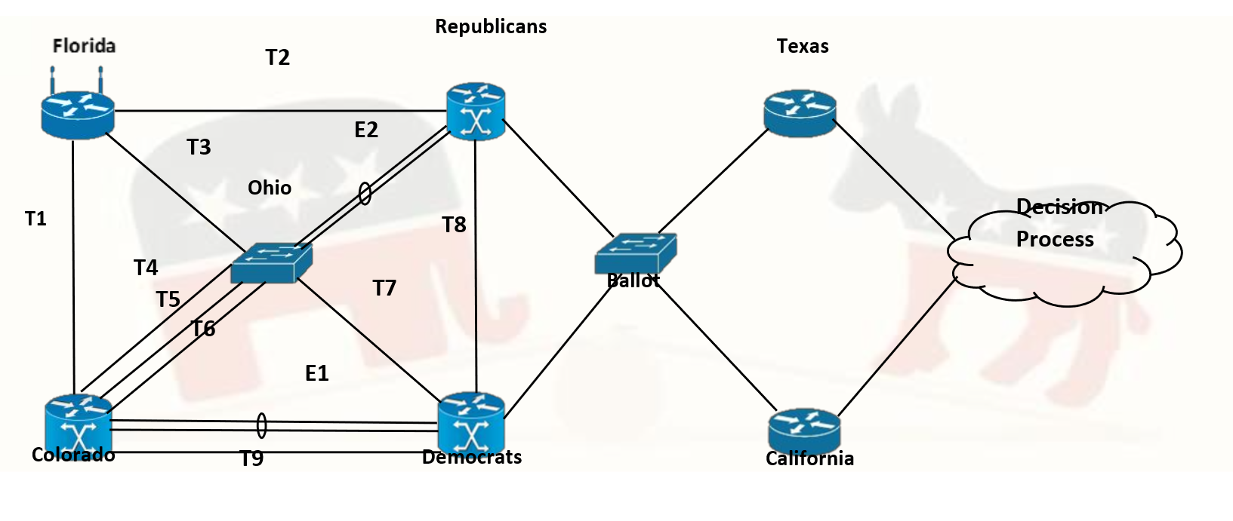
Custom topology/addressing per student

Slide 4
Practical
Layer 2 (real/virtual)

Slide 5
Practical
Layer 3 (real/virtual)

Slide 6
Grading
Execution/ Configuration
Day 1 individually, no makeup option
Redo, Collaborate, complete solution
Interview
If you cant explain and demonstrate operation, we cant grant you the points
Theoretical explanation will not count, but rather explain your applied solution.

Slide 7
Practical next week
Practice week
Solve 2 sample midterms (divide and conquer)
Discuss outside of lab, mechanize process
Exam
Bring your lab reports
Manage time properly
Multiple Small Hits / Big Homerun
Written on Mar 7th (might release video for lecture)

Slide 8
Written
IP Addressing (think midterm practical)
STP (example released today)
Routing Table
Minimal CLI ( don’t memorize but understand what a config means)
IMPORTANT: -1 rule.
Partial Assurance.

Slide 9
Written
OSPF
DR/BDR selection
LSA’s
Router ID
HSRP
Prococol operation at Layer2 and Layer 3
Preempt, Tracking
Etherchannel
PaPG /LACP
Load Balancing

Slide 10
Written
BVI / IRB
Switch internal operation
Router internal operation

Slide 11
Routing table
O 10.0.0.0/24 (110/20)
S 10.0.0.0/25 (1/0)
D 10.0.0.0/24 (90/200)
O E 10.0.0.0/24 (110/10)
R 10.0.0.0 /16 (120/10)
R 20.0.0.0 /24 (120/15)

Slide 12
Never Enough Time
Think critically.
Make tradeoffs

Slide 13
Good Luck!!

